Slide 1
WeatherGNN Exploiting Meteo- and Spatial-Dependencies for Local NWP Bias-Correction
Zheng Zhou
2025.6

Slide 2
Outline
01
Introduction and Motivation
05
Experimental Design and Results
02
Overview of Traditional Methods
06
Summary and Future Work
03
Introduction to GNN and Its Applicability
04
Architecture of WeatherGNN

Slide 3
01
PART
Introduction and Motivation

Slide 4
Introduction to Numerical Weather Prediction
Basic Principles of NWP
Challenges of Local Biases
Numerical Weather Prediction (NWP) simulates atmospheric motion through mathematical models and computers to forecast future weather. It is widely used in meteorology but suffers from systematic biases in local areas.
Local weather is influenced by complex factors like terrain and microclimate, causing systematic biases in NWP models. This is particularly problematic for high- precision short- term forecasting in scenarios such as wind farms.
Notes:
So first what is the NWP, Numerical Weather Prediction use historical information to make the prediction of weather in the furture based on math models
Terrain地形
Microclimate小型气候
WeatherGNN gives the bias correction of those factors

Slide 5
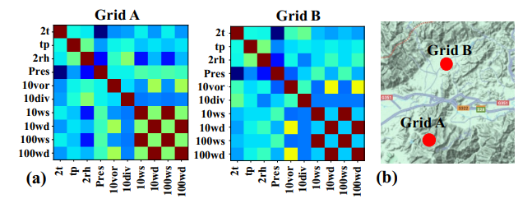
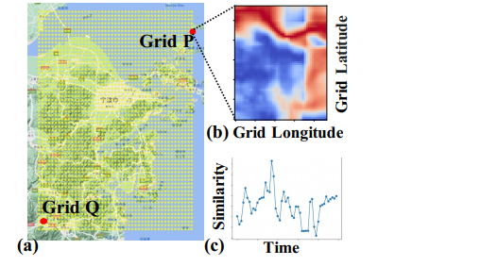
Specific Problems
Distant points can have similar properties to
nearby points based on geographic characteristics
Two similar points have different correlation coefficients
Notes:
Figure 2: (a) Grid Distribution and Terrain of Ningbo Dataset. (b) DTWSimilarity of Half-month 100m Wind Speed between Grid P and Other Grids. (c) DTW Similarity of 100m Wind Speed with a Six-hour Time Range between Grid P and Grid Q.

Slide 6
02
PART
Overview of Traditional Methods

Slide 7
Statistical and Filtering Methods
Limitations of Statistical Methods
Shortcomings of Kalman Filtering
Traditional statistical methods like mean, variance, and trend regression are simple but only handle linear relationships, ignoring complex interactions between meteorological factors.
Kalman filtering and linear correction methods can dynamically adjust forecasts but are limited in modeling nonlinear relationships in complex meteorological systems.
Hongwei Yang, Jie Yan, Yongqian Liu, Zongpeng Song,
Statistical downscaling of numerical weather prediction based on convolutional neural networks,
Global Energy Interconnection,
Volume 5, Issue 2,
2022,
@article{lynch2014simplified, title={Simplified method to derive the Kalman Filter covariance matrices to predict wind speeds from a NWP model}, author={Lynch, Conor and OMahony, Michael J and Scully, Ted}, journal={Energy procedia}, volume={62}, pages={676--685}, year={2014}, publisher={Elsevier} }

Slide 8
Deep Learning Methods
Advantages of CNN and RNN
CNN and RNN methods enhance nonlinear modeling capabilities and can capture temporal fluctuations but lack spatial propagation modeling.
Deficiencies of Existing Methods
Existing deep learning methods, such as CNN and RNN, neglect interactions between meteorological factors and spatial propagation, leading to suboptimal performance in complex scenarios.
@article{zang2023modified,
title={A modified RNN-based deep learning method for prediction of atmospheric visibility},
author={Zang, Zengliang and Bao, Xulun and Li, Yi and Qu, Youming and Niu, Dan and Liu, Ning and Chen, Xisong},
journal={Remote Sensing},,
year={2023},
}
Notes:
CNN和RNN增强了非线性特征的时间序列上的特征进行预测，但依然缺乏对于空间传播的建模，目前已有的方法

Slide 9
03
PART
Introduction to GNN and Its Applicability

Slide 10
Core Advantages of GNN
Graph Structure Modeling Capability
Design Philosophy of WeatherGNN
Graph Neural Networks (GNNs) are suitable for graph structure modeling, effectively handling dependencies between nodes and supporting spatial propagation modeling. They are ideal for modeling complex relationships between geographical locations and meteorological factors. Traditional neural networks, such as Convolutional Neural Networks (CNN) and Recurrent Neural Networks (RNN), mainly deal with lattice-like data or sequence data. GNNs, on the other hand, specialie in processing graph-structured data and are better able to capture the relationships and dependencies between nodes
WeatherGNN is designed based on the GNN framework to address the shortcomings of traditional methods and improve the accuracy of local weather forecasting through graph structure modeling.
@article{wu2023weathergnn,
title={Weathergnn: Exploiting meteo-and spatial-dependencies for local numerical weather prediction bias-correction},
author={Wu, Binqing and Chen, Weiqi and Wang, Wengwei and Peng, Bingqing and Sun, Liang and Chen, Ling},
journal={arXiv preprint arXiv:2310.05517},
year={2023}
}

Slide 11
04
PART
Architecture of WeatherGNN

Slide 12
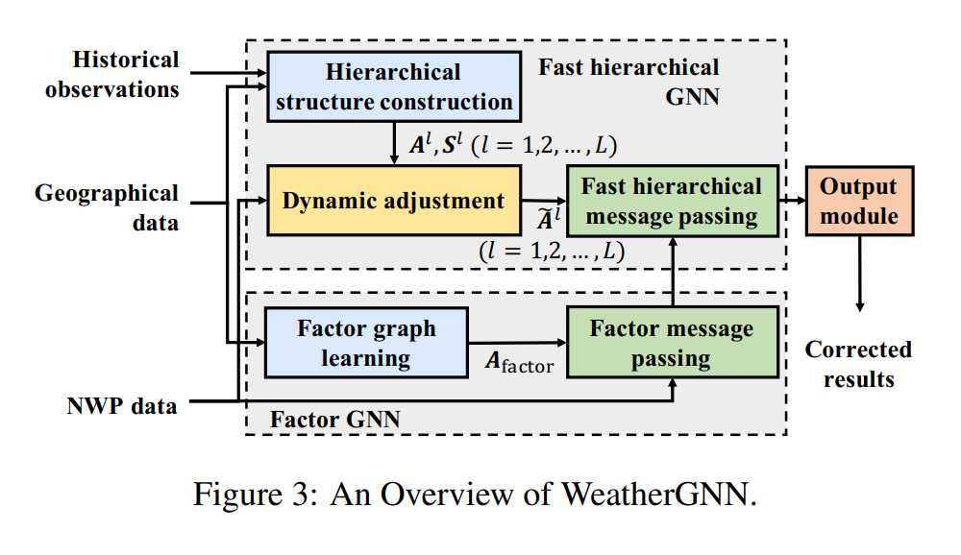
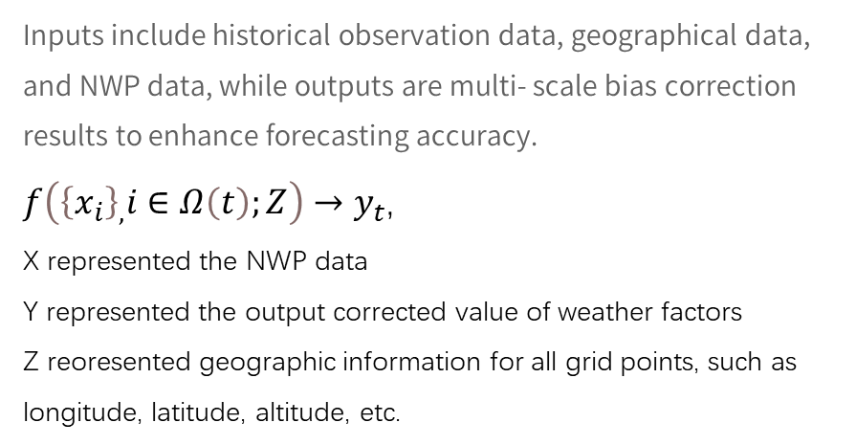
Components of the Architecture
Two Submodules
WeatherGNN consists of two submodules: Factor GNN for modeling meteorological factor dependencies and Fast Hierarchical GNN for modeling spatial hierarchical propagation.
Inputs and Outputs
Inputs include historical observation data, geographical data, and NWP data, while outputs are multi- scale bias correction results to enhance forecasting accuracy.
​$f\left({\left\{x_{i}\right\}}_{,}i∈Ω\left(t\right);Z\right)→y_{t}$,
X represented the NWP data
Y represented the output corrected value of weather factors
Z reoresented geographic information for all grid points, such as longitude, latitude, altitude, etc.

Slide 13
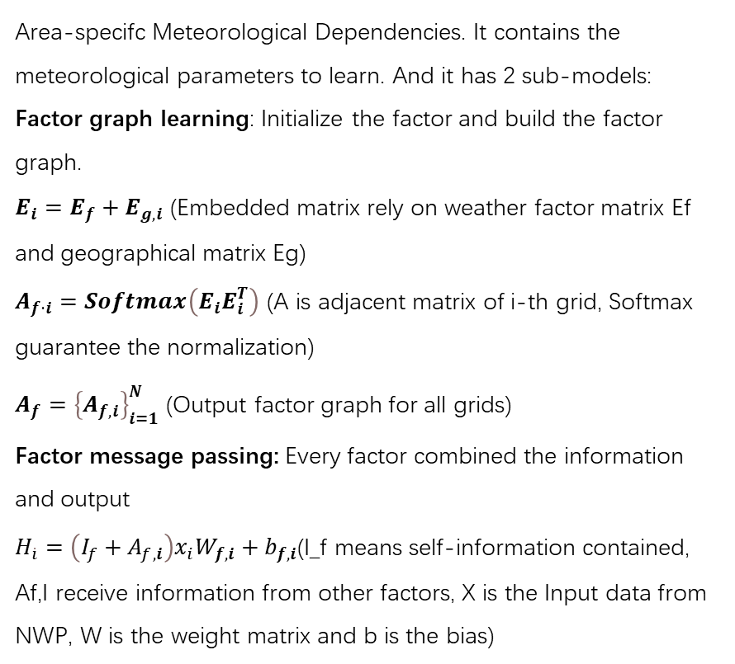
Components of the Architecture
Factor GNN
Area-specifc Meteorological Dependencies. It contains the meteorological parameters to learn. And it has 2 sub-models:
Factor graph learning: Initialize the factor and build the factor graph.
$E_{i}=E_{f}+E_{g,i}$ (Embedded matrix rely on weather factor matrix Ef and geographical matrix Eg)
$A_{f⋅i}=Softmax\left(E_{i}E_{i}^{T}\right)$ (A is adjacent matrix of i-th grid, Softmax guarantee the normalization)
$A_{f}={\left\{A_{f,i}\right\}}_{i=1}^{N}$ (Output factor graph for all grids)
Factor message passing: Every factor combined the information and output
$H_{\dot{i}}=\left(I_{f}+A_{f,i}\right)x_{i}W_{f,i}+b_{f,i}$(I_f means self-information contained, Af,I receive information from other factors, X is the Input data from NWP, W is the weight matrix and b is the bias)

Slide 14
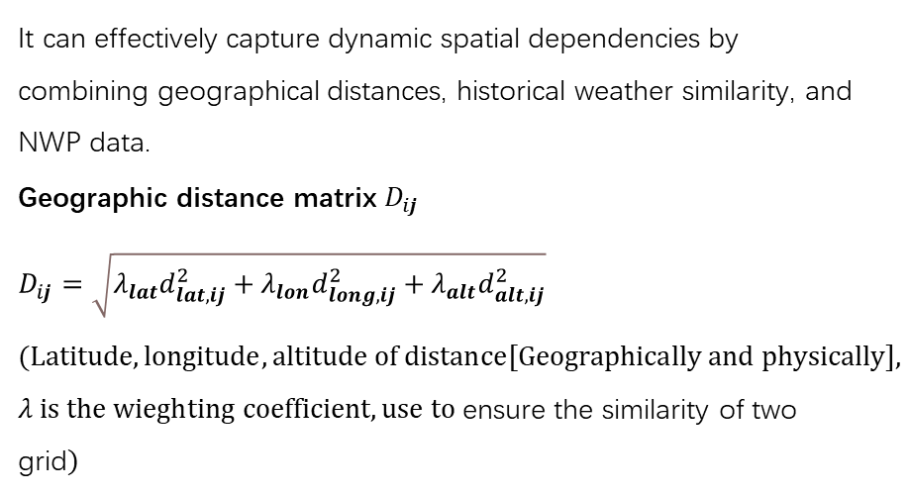
Components of the Architecture
Fast Hierarchical GNN
It can effectively capture dynamic spatial dependencies by combining geographical distances, historical weather similarity, and NWP data.
Geographic distance matrix $D_{ij}$
$$D_{ij}=\sqrt{λ_{lat}d_{lat,ij}^{2}+λ_{lon}d_{long,ij}^{2}+λ_{alt}d_{alt,ij}^{2}}$$
$$(Latitude, longitude, altitude of distance[Geographically and physically],$$
$λ is the wieghting coefficient,use to$ensure the similarity of two grid$)$

Slide 15
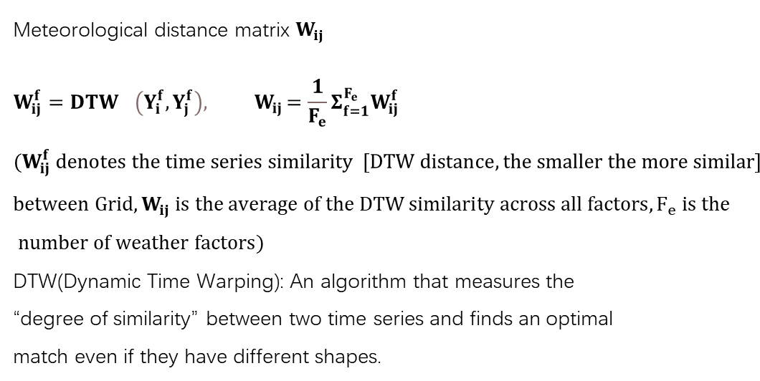
Components of the Architecture
Fast Hierarchical GNN
Meteorological distance matrix $W_{ij}$
$$W_{ij}^{f}={DTW}^{}{\left(Y_{i}^{f},Y_{j}^{f}\right){, W}_{ij}=\frac{1}{F_{e}}Σ_{f=1}^{F_{e}}W_{ij}^{f}}^{}$$
$$(W_{ij}^{f} denotes the time series similarity \left[DTW distance, the smaller the more similar\right]$$
$$between Grid,W_{ij} is the average of the DTW similarity across all factors,F_{e} is the$$
$number of weather factors)$
DTW(Dynamic Time Warping): An algorithm that measures the “degree of similarity” between two time series and finds an optimal match even if they have different shapes.
Notes:
Wij和Wijf是DTW distance matrix of grid I and j for weather factor f and all weather factors

Slide 16
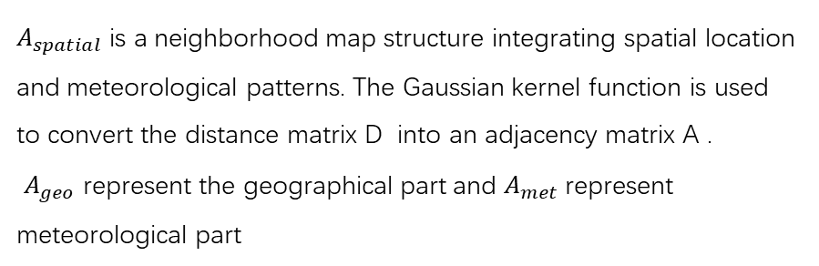

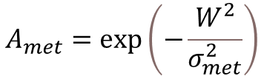
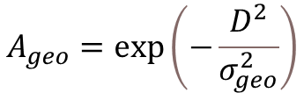
Components of the Architecture
Fast Hierarchical GNN
$A_{spatial}$is a neighborhood map structure integrating spatial location and meteorological patterns. The Gaussian kernel function is used to convert the distance matrix D into an adjacency matrix A .
​ $A_{geo}$ represent the geographical part and $A_{met}$represent meteorological part
$$A_{geo}=\exp\left(−\frac{D^{2}}{σ_{geo}^{2}}\right)$$
$$A_{met}=\exp\left(−\frac{W^{2}}{σ_{met}^{2}}\right)$$
$A_{spatial}=$ $A_{geo}$ + $A_{met}$

Slide 17
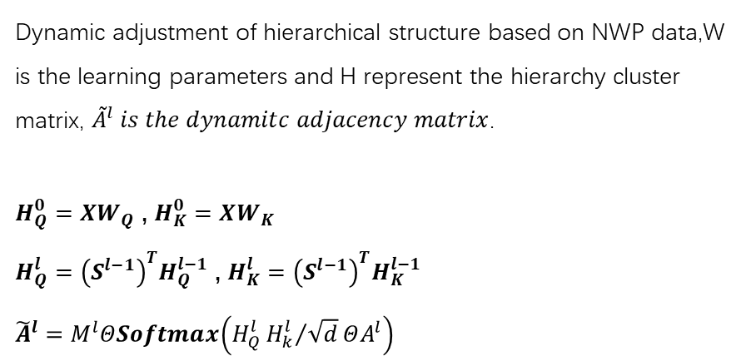
Components of the Architecture
Fast Hierarchical GNN
Dynamic adjustment of hierarchical structure based on NWP data,W is the learning parameters and H represent the hierarchy cluster matrix, ${\tilde{A}}^{l} is the dynamitc adjacency matrix$.
$H_{Q}^{0}=XW_{Q}$ , $H_{K}^{0}=XW_{K}$
$H_{Q}^{l}={\left(S^{l−1}\right)}^{T}H_{Q}^{l−1}$ , $H_{K}^{l}={\left(S^{l−1}\right)}^{T}H_{K}^{l−1}$
$${\tilde{A}}^{l}=M^{l}ΘSoftmax\left(H_{Q}^{l}{H_{k}^{l}}/{\sqrt{d}}ΘA^{l}\right)$$
Notes:
最后一个公式 那个符号是中间一个圆里面一个点，表示元素乘积（element-wise product）
A^l表示A的第l层，A^0 = A_spatial
S是传播矩阵，assignment matrix, all value from 0-1
Hk和Hq是注意力机制的查询和键Query和Key
M是mask matrix,d是scaling factor
Hi ∈ RFe×d is the corresponding output considering meteorologi cal dependencies.

Slide 18
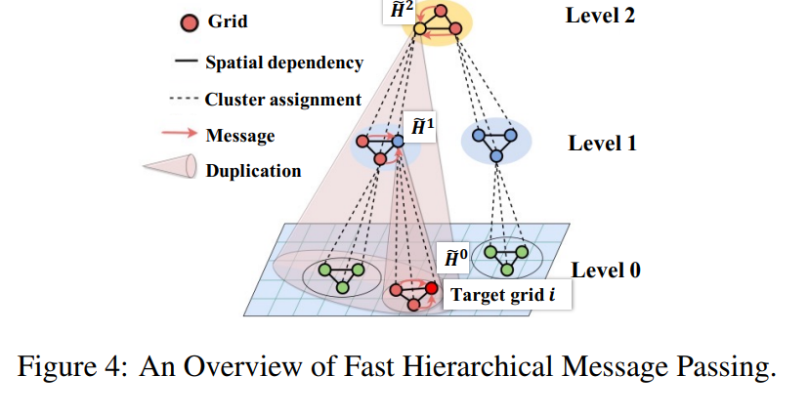
Components of the Architecture
Fast Hierarchical GNN
Last part is called Fast Hierarchical Message Passing. It calculate local message by linear projection and Neighborhood Information Aggregation ,pass the message to level 0 and update it .

Slide 19
05
PART
Experimental Design and Results

Slide 20
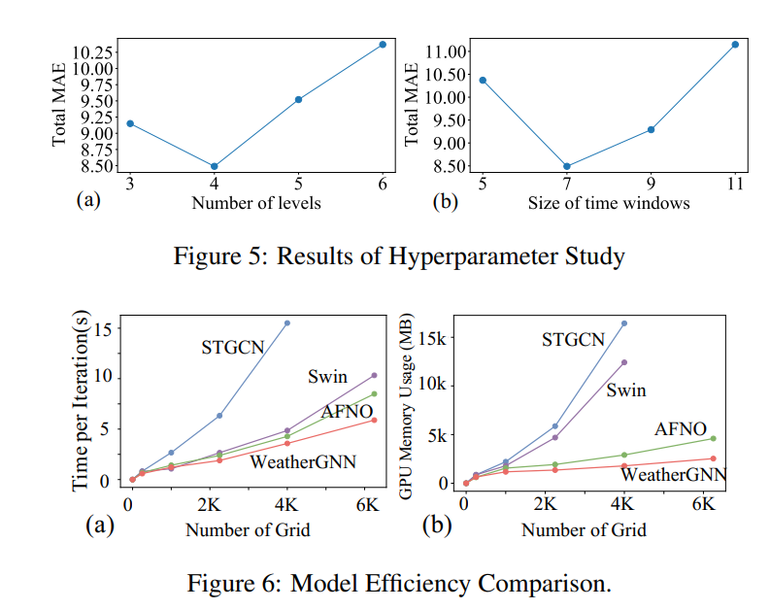
Experimental Comparison
Result Analysis
Figure 5 shows the effect of the number of layers on the MAE as well as the effect of the time window size on the MAE, concluding that the best results are achieved with 4 layers and a time window of 7.
Figure 6 shows the efficiency comparison between the models, WeatherGNN has a short running time and low memory usage, which is the optimal solution among the current models.
Notes:
MAE Mean absolute Error,所以图5在lvl4和time window 7表现最好
图6展现了在初始环境下各个方法效率差不多，但是在更高的grid数量的情况下WeatherGNN总是最快的那个，表现最好

Slide 21
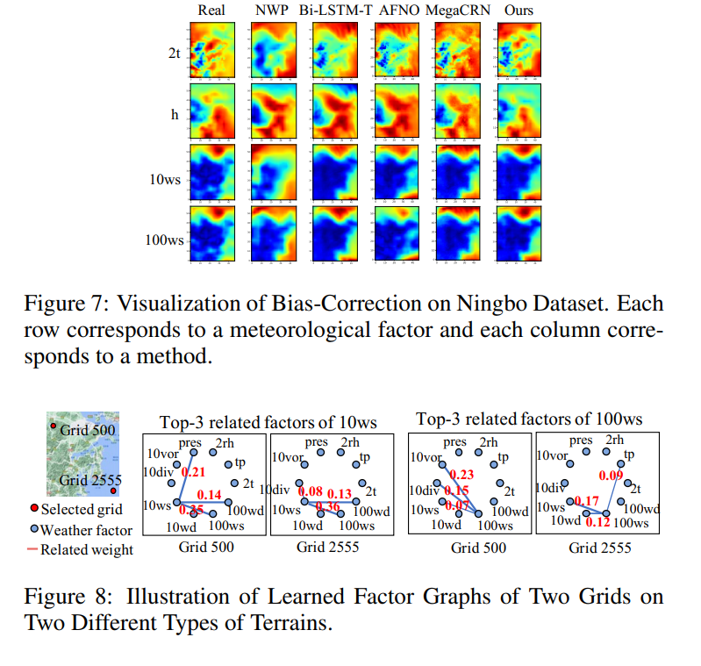
Experimental Comparison
Result Analysis
Figure 7 shows the bias-corrected visualization, with the highest similarity to the real situation doing the comparison weatherGNN
Figure 8 is a factor map visualization. It shows the dependence between the meteorological factors of the different grids of the two terrains

Slide 22
Experimental Comparison
Comparison with Traditional Methods
WeatherGNN is compared with traditional NWP and other methods like AFNO, and it outperforms baseline models in multiple regions for wind forecasting, with smaller biases and clearer structures.
Result Analysis
Experimental results show that WeatherGNN performs excellently in bias correction, with better interpretability and effective enhancement of local weather forecasting accuracy. use Mean Absolute Error (MAE) and Root Mean Square Error (RMSE) to measure the performance of all methods.

Slide 23
06
PART
Summary and Future Work

Slide 24
Advantages and Limitations of WeatherGNN
Future work
Nonlinear Modeling Capability
This paper demonstrates the superiority of weatherGNN in capturing features of meteorological and geographic factors for predicting climate over a specific region, and its scalability and robustness in other areas such as weather forecasting and downsampling can be considered in the future.
WeatherGNN has the capability for nonlinear, cross- factor, and cross- regional modeling, with a clear and interpretable model structure, effectively handling complex meteorological systems.
01
02

Slide 25
Thanks For Your Attention

